Slide 1

Relationships
Presented by:
Elizer Ponio Jr.

Slide 2
Relationships in Java
Inheritance
Association
Aggregation
Composition

Slide 3
Inheritance
An “is a” relationship signifies that one class is a type of another. It is implemented in java using ‘extends’ and ‘implements’ keywords.
Example:
A cat is a type of pet.
A dog is a type of pet.
A rabbit is a type of pet.

Slide 4
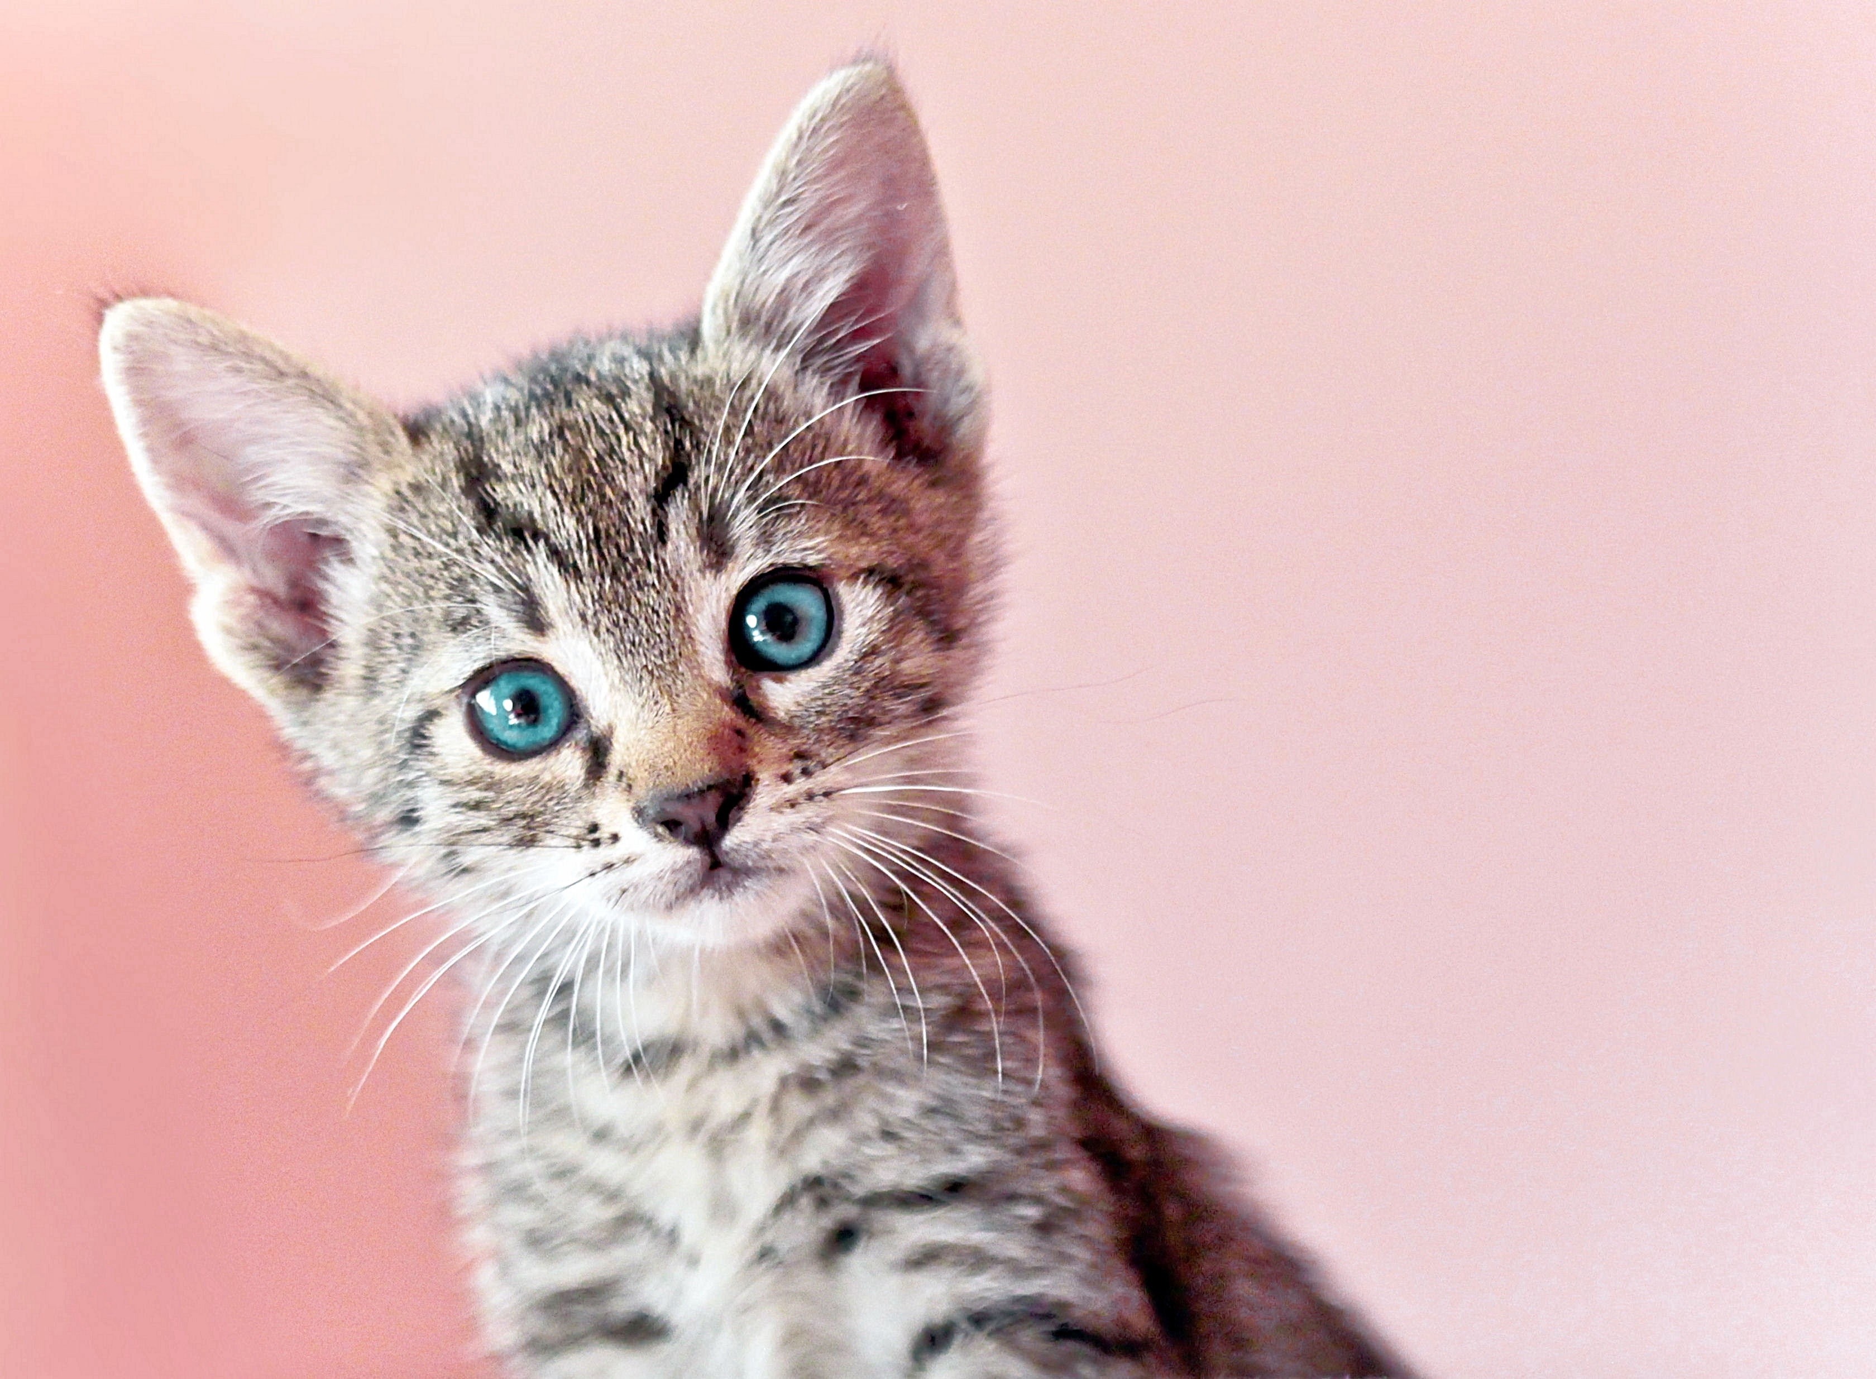

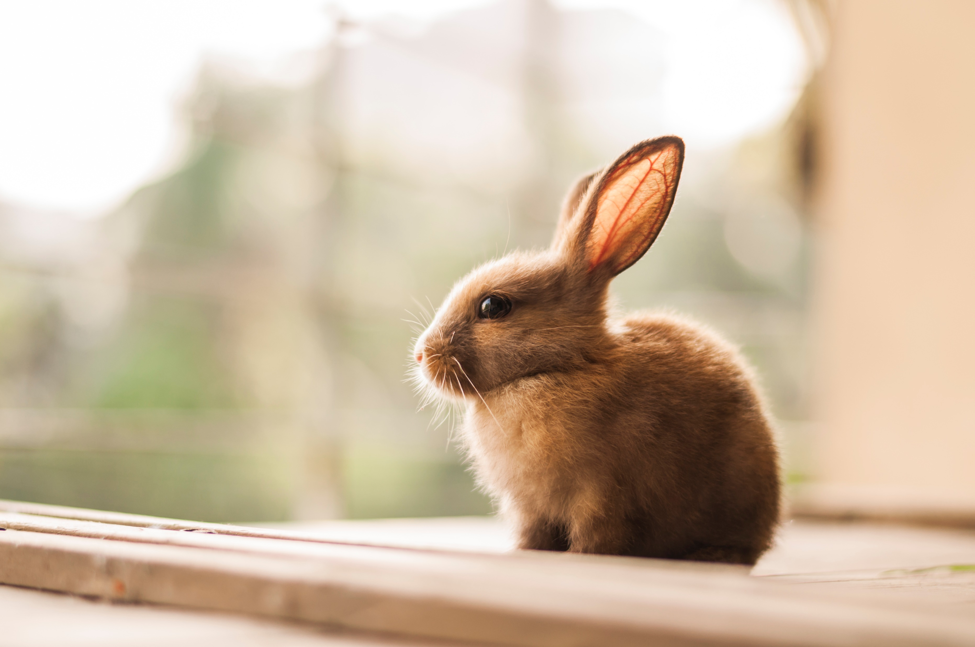
Inheritance
Pet
int name int age
setName() eat()
Cat
Dog
Rabbit
int name
int age
int name
int age
int name
int age

Slide 5
Inheritance
Pet
int name int age
setName() eat()
Superclass/Parent Class
Cat
Dog
Rabbit
int tailLength
Subclass/Child Class
Subclass/Child Class
Subclass/Child Class
You can add an attribute only specific to a subclass.

Slide 6
Inheritance
Pet
int name int age
setName() eat()
String birthday
Cat
Dog
Rabbit
If we add a new attribute, this will be applied to all subclasses.

Slide 7
Association
A basic relationship or connection between two separate classes.
Example:
A cat eats fish.

Slide 8
Association
Pet
int name int age
setName() eat()
Cat
Dog
Rabbit
eats
Fish

Slide 9
Aggregation
In aggregation, each class have independent existence and they are not tied to each other.
Example:
A wolf can be part of a pack but it can also survive on its own.

Slide 10
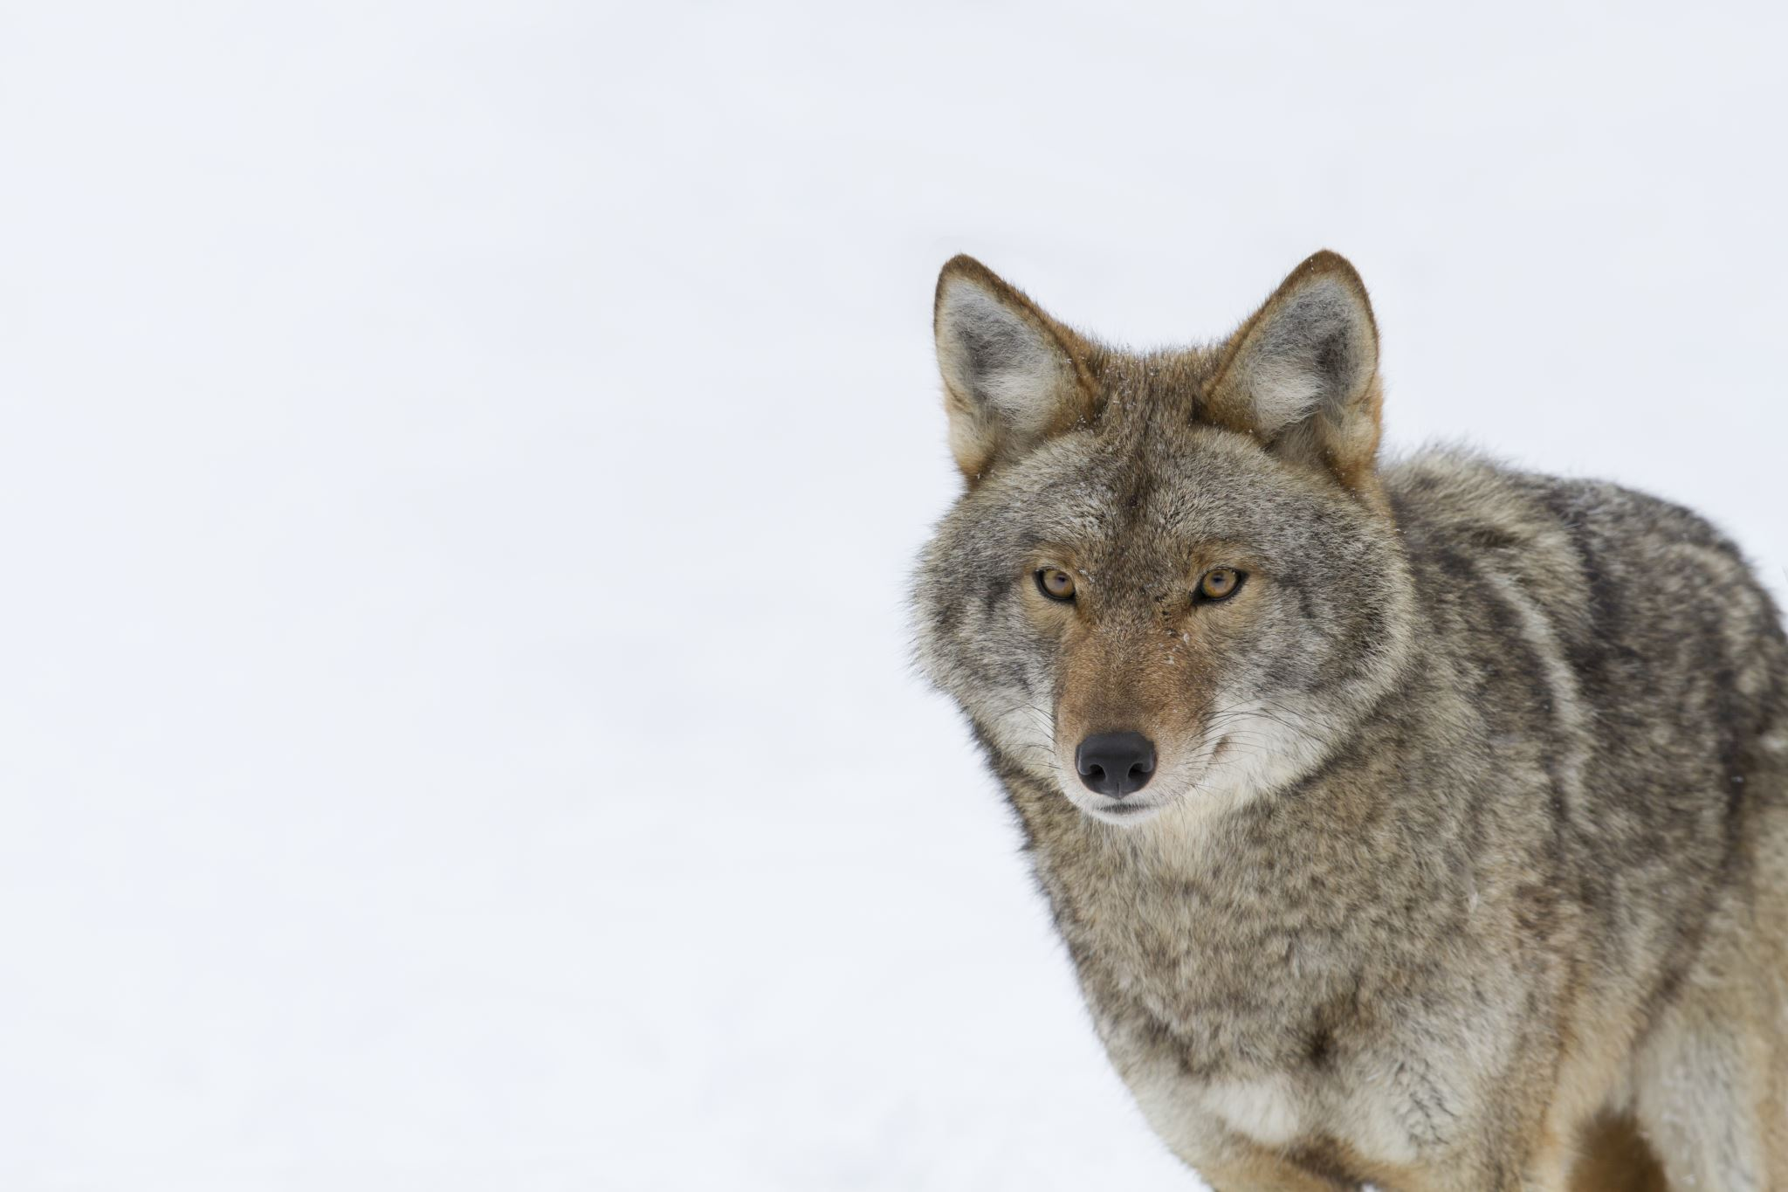
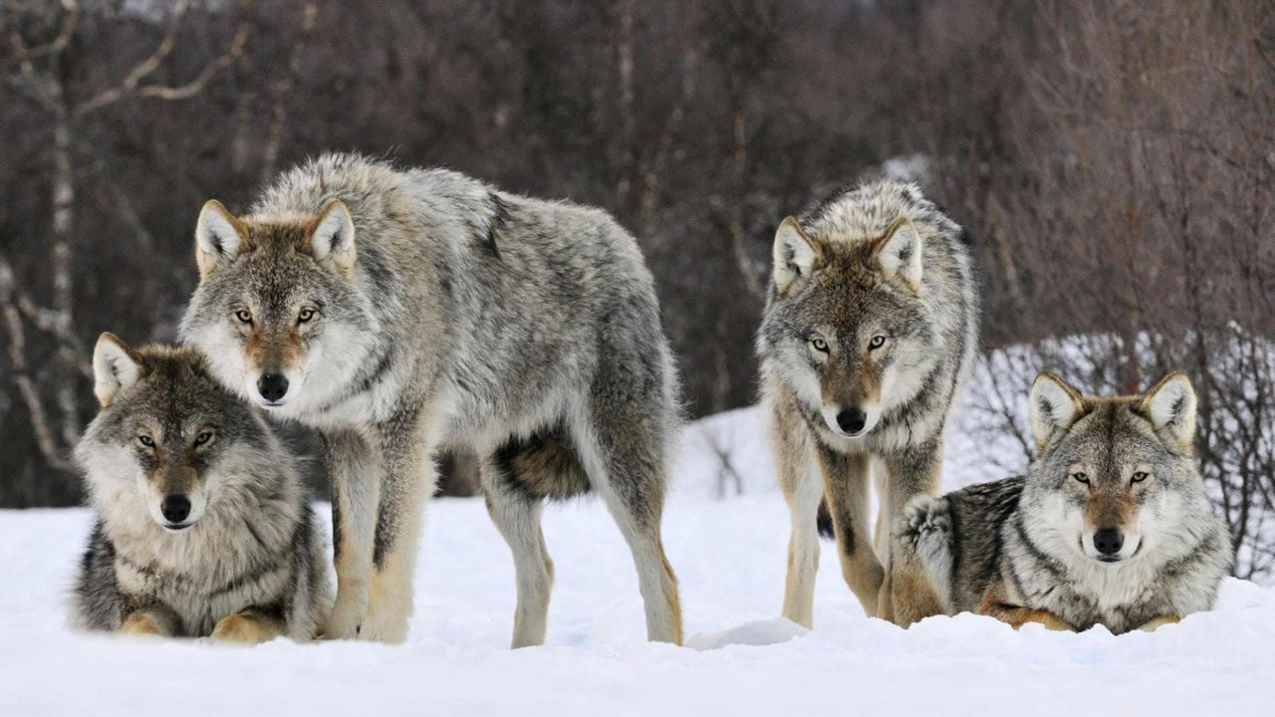
Aggregation
Wolf
Wolfpack

Slide 11
Composition
In composition, an object belongs to a larger object. If the larger object is destroyed, the all the objects in it will be also destroyed.
Example:
Plants and animals need water to survive. If there is no water, then there will be no plants and animals.

Slide 12
Composition
Water
Plants
Animals

